Slide 1
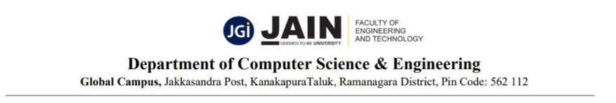
RISK ADAPTIVE VOICE-BASED
FINANCE ASSISTANT
(Sub-title: Secure Digital Payment System using Speaker Verification and Fraud Detection)
Presentation By,
Dhanush I (23BTRCL192) – AIML B
Jahnavi K (23BTRCL202) – AIML B
Balaram K (23BTRCL201) – AIML B
Ravi Sankar K (23BTRCL198) – AIML B
Kundan K (23BTRCL197) – AIML B
Jathin G (23BTRCL243) – AIML B
Guided By,
S. Srinivas Kumar,
Assistant Professor / CSE- AIML
CoEpcl-30

Slide 2
CONTENTS
Abstract
Introduction
Problem Definition
Existing Payment System
Project Objectives
Proposed System
Architecture Diagram
Tech Stack & Features
Working of System
Experimental Results
Future Scope
Conclusion
References

Slide 3
ABSTRACT
Voice-based payments are becoming more popular due to convenience.
Existing payment systems require multiple manual steps and are vulnerable to fraud.
The proposed system uses Whisper, BiLSTM, ECAPA-TDNN, Isolation Forest, and Razorpay.
The system performs speech recognition, intent detection, speaker verification, fraud detection, and adaptive authentication.
The system allows secure payments using a single voice command.

Slide 4
INTRODUCTION
Traditional payment systems require multiple steps.
Elderly and visually impaired users face difficulty using current apps.
Voice-based systems improve convenience.
Security is important in voice payments.
Proposed system combines AI and fraud detection for safer payments.

Slide 5
PROBLEM DEFINITION
Multiple manual steps in current payment systems
Passwords and PINs can be stolen
Voice replay attacks are possible
Fraudulent transactions are difficult to detect
Need for secure and intelligent payment assistant

Slide 6
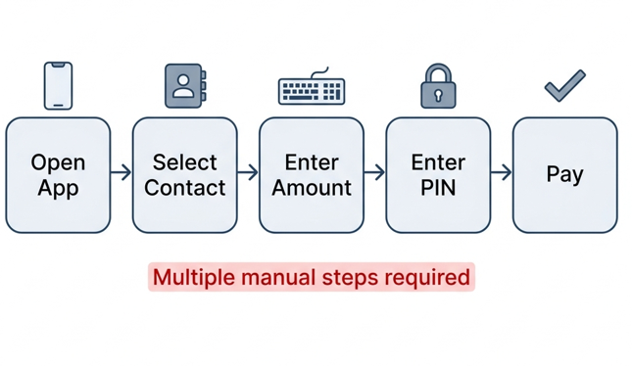
EXISTING PAYMENT SYSTEM
Disadvantages:
Multiple manual steps
Time-consuming
Less user-friendly (repetitive)

Slide 7
PROJECT OBJECTIVES
The main objective of this project is to:
Convert speech into text
Detect payment intent
Verify speaker identity
Detect fraud risk
Reduce manual payment steps
Improve user convenience
Provide adaptive authentication

Slide 8
PROPOSED SYSTEM
The proposed system allows the user to perform transactions through a single voice command.
Whisper converts speech to text (very accurate)
The intent classification model identifies the type of transaction requested by the user.
ECAPA-TDNN verifies whether the speaker is genuine or not.
Fraud detection models analyse transaction behaviour and generate a risk score.
Razorpay completes transaction.
Based on the risk level, the system approves, blocks, or requests step-up authentication.

Slide 9
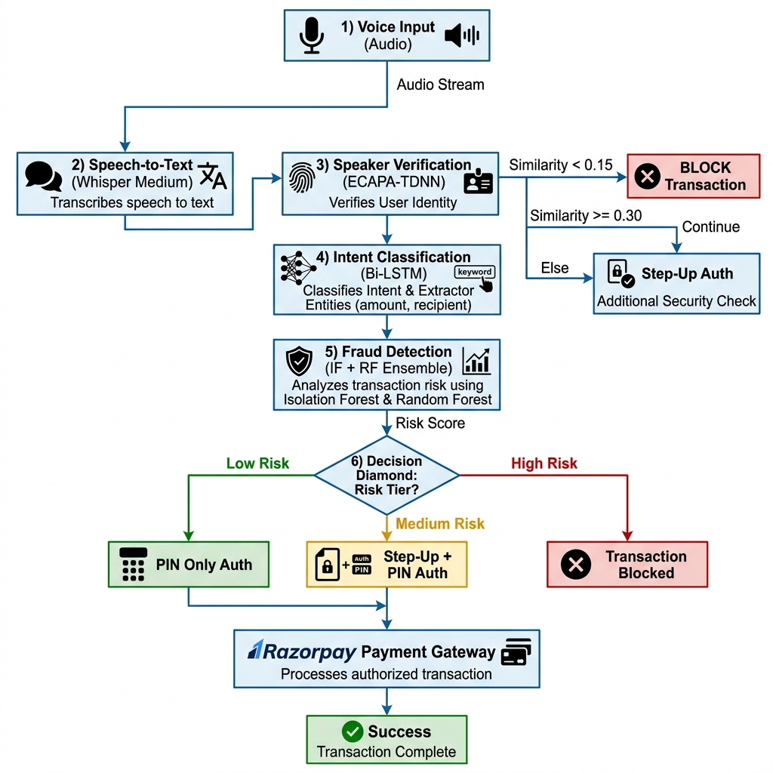

Slide 10
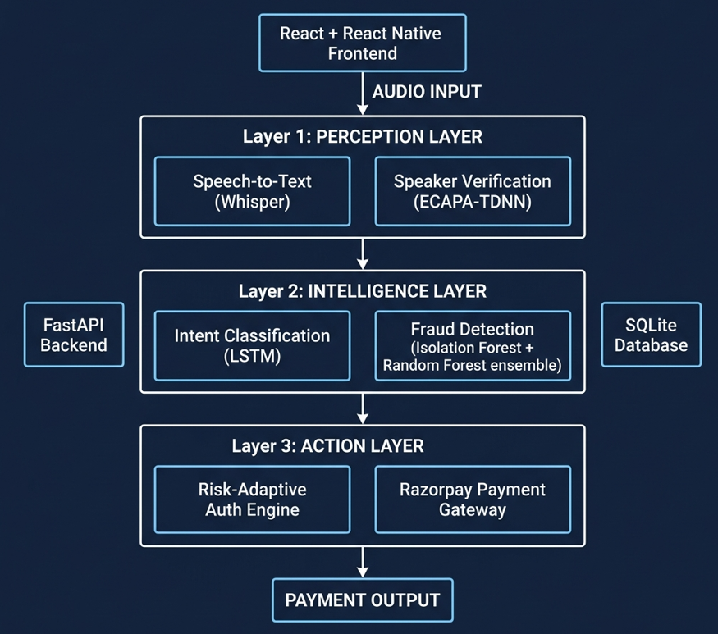
ARCHITECTURE DIAGRAM

Slide 11
TECH STACK & FEATURES
React JS & FastAPI
Whisper
BiLSTM
ECAPA-TDNN
Isolation Forest
Random Forest
SQLite
Razorpay
Voice-Based Payment
Fraud Detection
Speaker Verification
Adaptive Authentication
Real-Time Processing

Slide 12
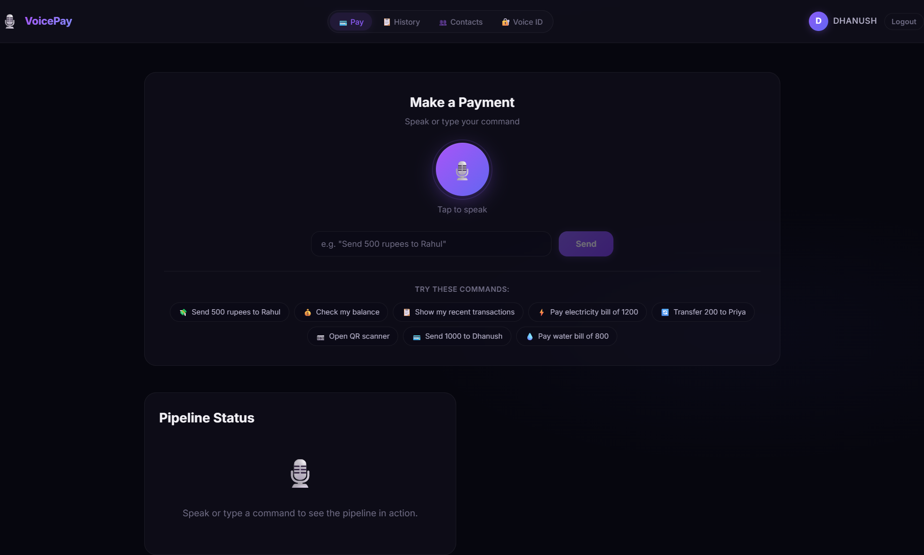
WORKING OF SYSTEM
Fig. The app interface (Web)

Slide 13
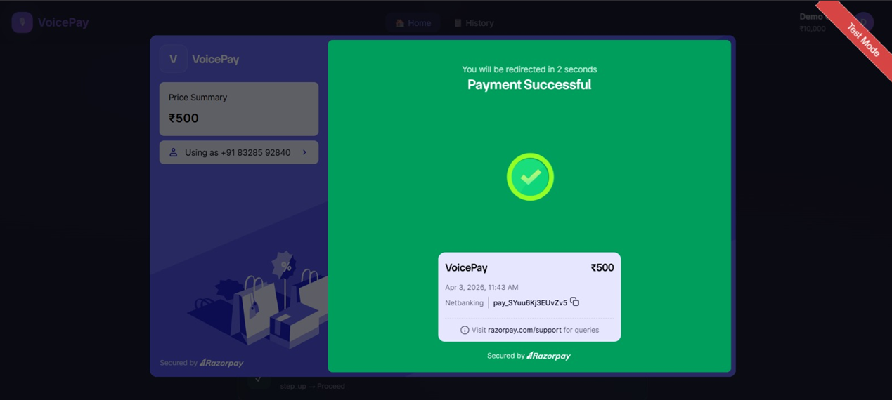
Fig. Entire working of the system

Slide 14
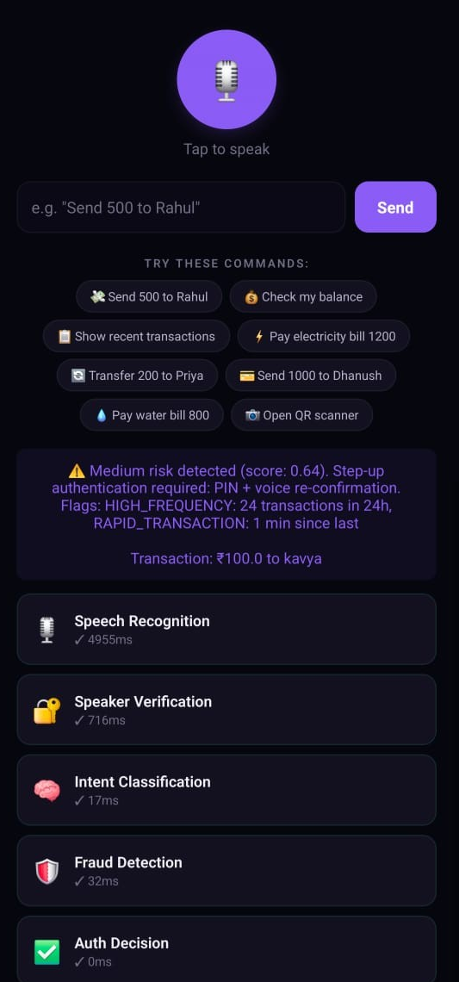
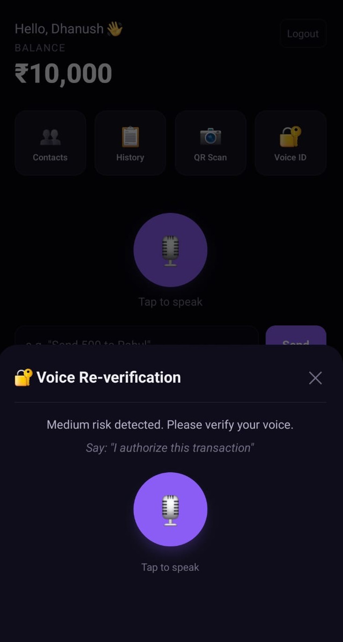
Fig. Mobile app Interface
Fig. Risk being detected

Slide 15
EXPERIMENTAL RESULTS
Whisper has highest latency
Fraud detection is fast
Genuine users score above 0.45
Imposter users remain below 0.35
Metrics:
Intent Classification Accuracy = 96.8%
Speech-to-Text Accuracy = 94.2%
Fraud Detection Accuracy = 93.7%
Speaker Verification Accuracy = 91.5%
All transactions were successfully processed in Razorpay test mode, with proper confirmation and receipt generation.

Slide 16
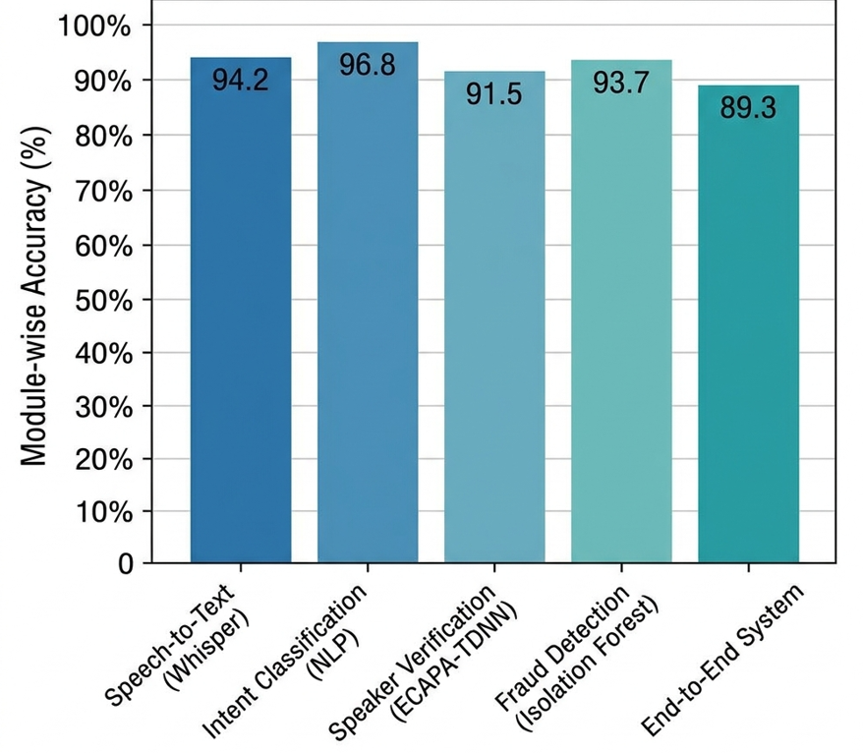

Slide 17
FUTURE SCOPE
Multilingual support
Mobile app integration
Face recognition
Advanced anti-spoofing
Cloud deployment
Support for more banking APIs

Slide 18
CONCLUSION
Proposed system provides secure voice-based payments
Reduces manual steps
Combines AI with fraud detection
Improves user convenience and security
Can be used in future digital banking systems

Slide 19
REFERENCES
[1] D. Jurafsky and J. H. Martin, Speech and Language Processing, 3rd ed., Pearson Education, 2023.
[2] L. Rabiner and B. Juang, Fundamentals of Speech Recognition. Englewood Cliffs, NJ: Prentice-Hall, 1993, pp. 1–25.
[3] R. Kumar and S. Singhal, “Natural Language Processing in FinTech: A Comprehensive Review,” IEEE Access, vol. 9, pp. 15432–15440, 2021.
[4] T. Hasan, M. Khan, and L. Zhou, “A Comprehensive Study on Vulnerabilities of Voice-Controlled Systems,” IEEE Internet of Things Journal, vol. 7, no. 5, pp. 4182–4191, 2020.
[5] H. Wang, Y. Zhang, and X. Liu, “Dynamic Risk-Based Authentication Paradigms in E-commerce,” Journal of Network and Computer Applications, vol. 118, pp. 78–86, 2018.
[6] M. Singh and A. Gupta, “Mel-Frequency Cepstral Coefficients for High-Fidelity Speech Recognition,” IEEE Signal Processing Letters, vol. 28, pp. 301–305, 2021.
[7] Y. Chen and Z. Wang, “Conditional Random Fields and Bi-LSTM Architectures for Named Entity Recognition in Financial Text,” Proc. Association for Computational Linguistics (ACL), 2019, pp. 104–110.

Slide 20
THANK YOU

